Slide 1
Project mid-term progress presentation Investigation on Atlantic Ocean Hurricanes
Cheuk Hang Ng
a1821087

Slide 2
Outline
Recap of previous work
Dataset Subset
Modeling & Results
Models Comparison
Future works

Slide 3
Recap of previous work
Explored whole dataset
Examined the data
Data cleaning
Summary dataframe

Slide 4
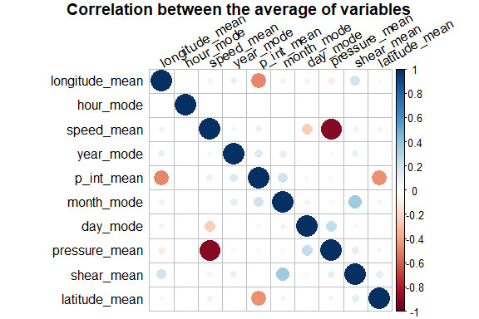
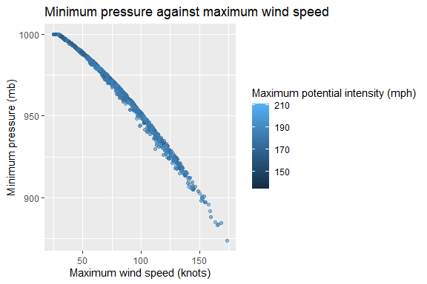
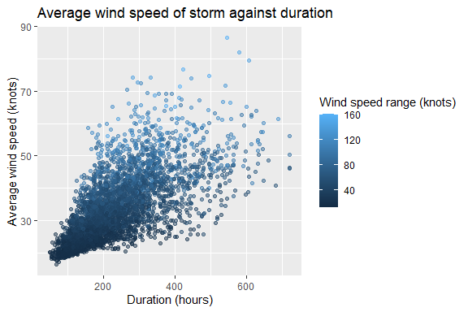
Recap of previous work
Exploratory data analysis
Correlation plot
Uni-/Bi-/Multi-variate analysis

Slide 5
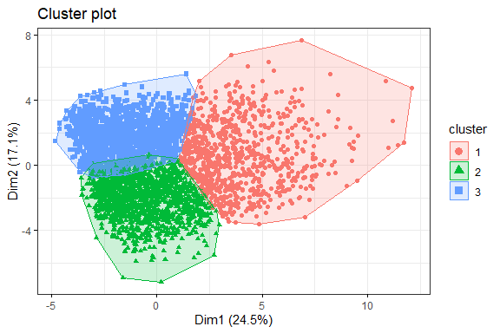
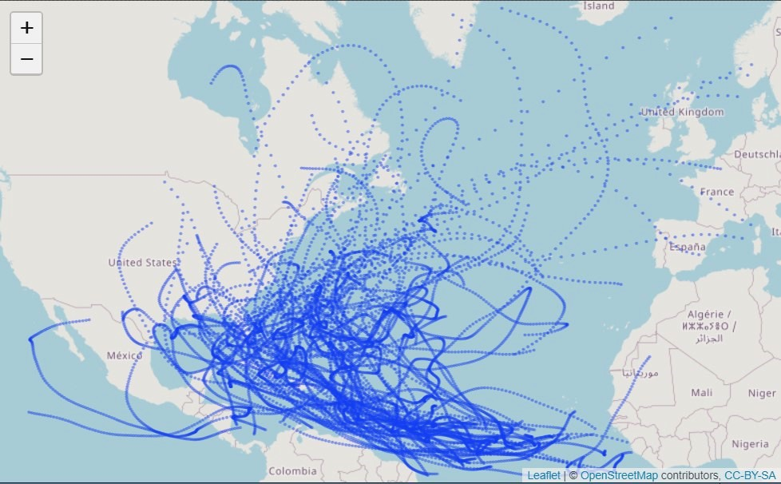
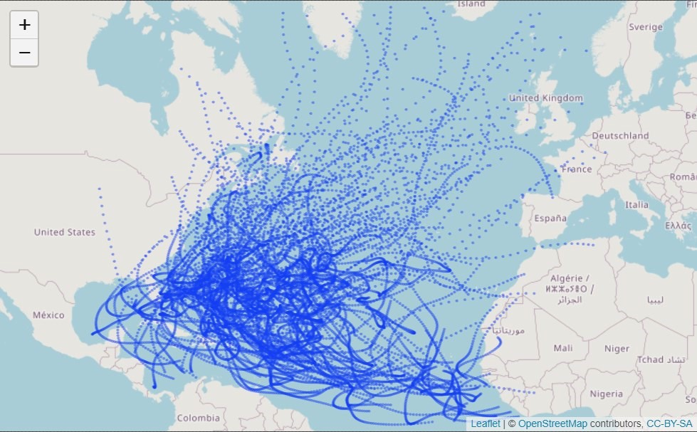
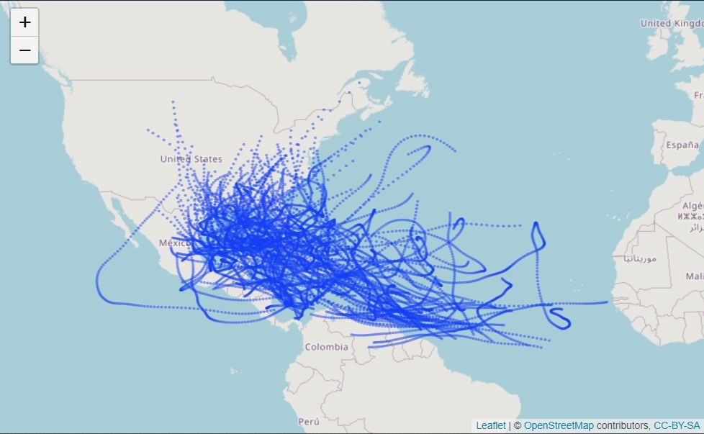
Recap of previous work
Data clustering
Storm tracks visualization

Slide 6
Dataset Subset
Subset high maximum speed storms
Storms with maximum speed >= 50
Subset consists of 2,145 storms instead 3,700 storms
Statistical summaries were drawn from times before the storms first speeded up to 50 knots
Why strong storms?
Interested in investigating strong storms
Strong storms means stronger characteristics
Why extract shorter time frames?
To see if we could predict the maximum storm strength and the presence/ absence of rapid intensification with limited information

Slide 7
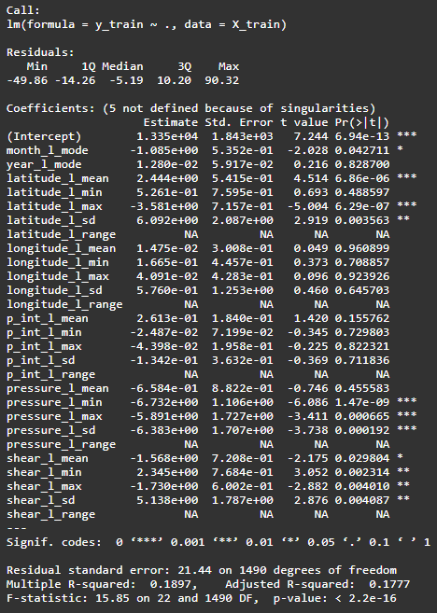
Modeling & Results
Linear regression model: predicting maximum wind speed
Simple to implement
Convenience for revealing the relations between the predictors and the response variable
Easy to evaluate
Observed:
P-value of F-statistic <2.2e-16
Residual standard error: 21.44
(Adjusted) R-squared ≈ 0.19 (0.18)
P-value of predictors ranged from 1.47e-9 to 0.9609
Some predictors are not defined due to singularities

Slide 8
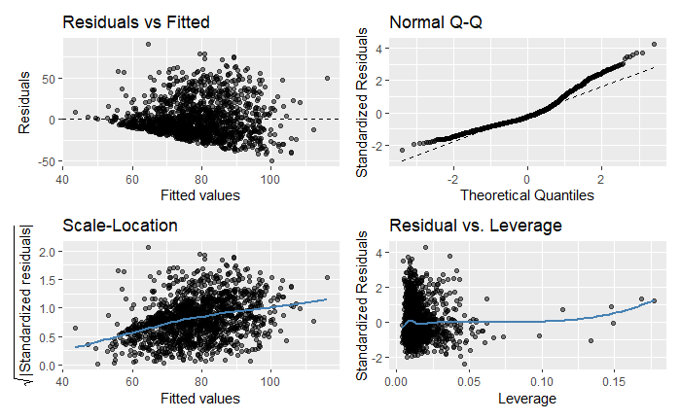
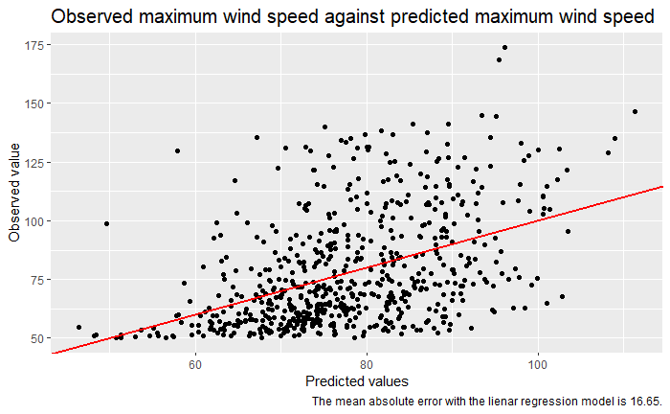
Modeling & Results
Linear regression diagnostic plots
Regression results visualised

Slide 9
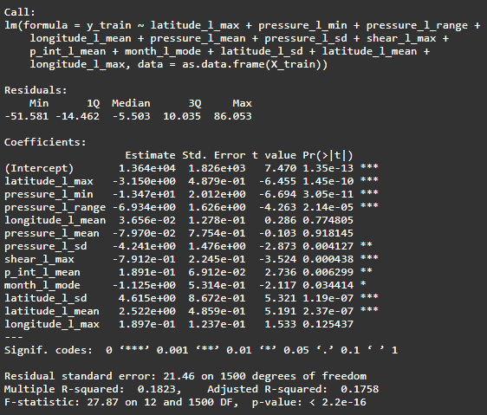
Modeling & Results
Linear regression model with forward stepwise regression: predicting maximum wind speed
Reduced predictors
Easy to implement
Observed:
P-value of F-statistic
<2.2e-16
Residual standard
error: 21.46
(Adjusted) R-squared
≈ 0.18
P-value of predictors
ranged from
3.05e-11 to 0.9181
Only 12 predictors

Slide 10
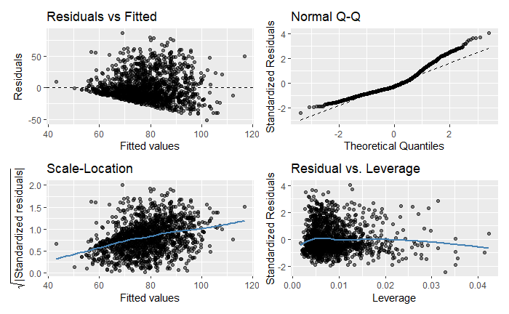
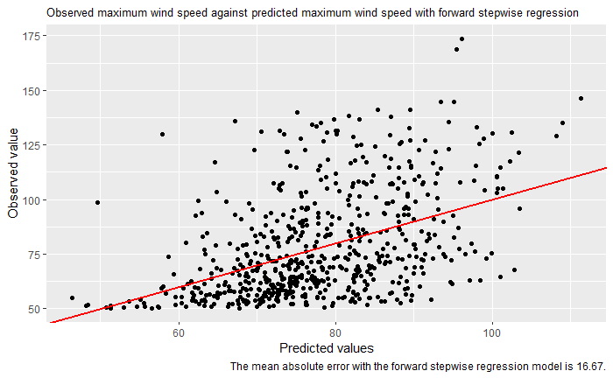
Modeling & Results
Linear regression diagnostic plots
Regression results visualised

Slide 11
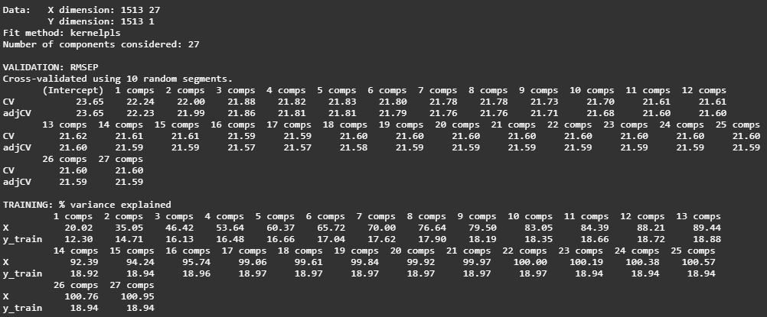
Modeling & Results
Partial Least Squares regression model: predicting maximum wind speed
Handle multicollinearity and correlation between predictors
Reduce number of predictors with focus on covariance
Observed:
RMSEP does not drop much with more than 3 components
Per centage of variance explained leveled out at 11 components

Slide 12
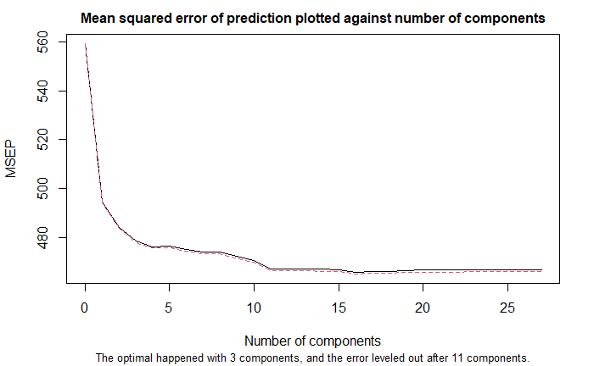
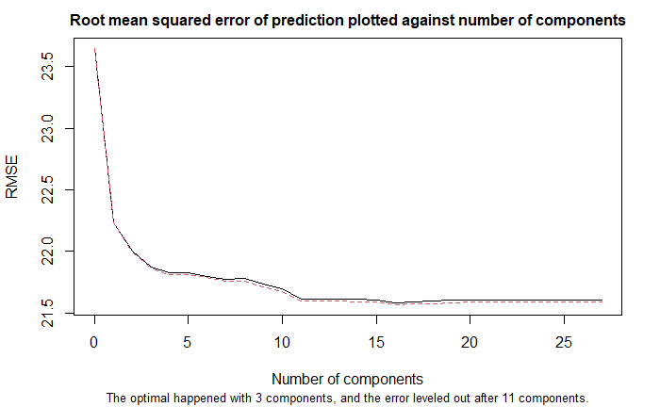
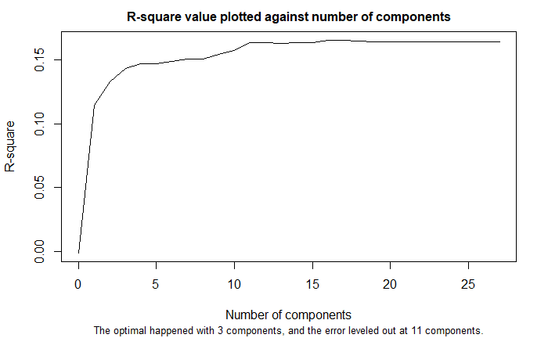
Modeling & Results
Partial Least Squares regression model: predicting maximum wind speed – Validate number of components

Slide 13
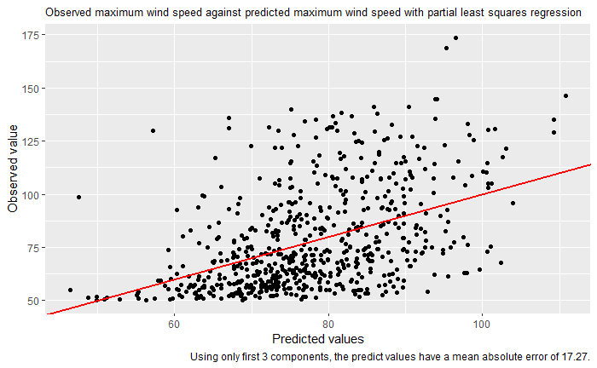
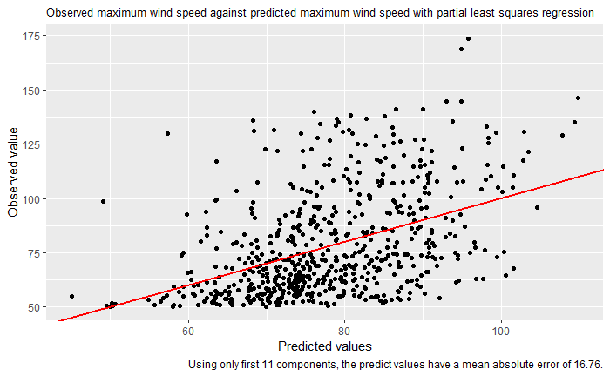
Modeling & Results
Partial Least Squares regression model: predicting maximum wind speed – regression results visualised

Slide 14
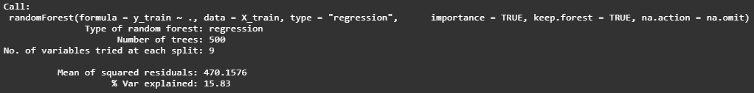
Modeling & Results
Random Forest Regression
Robust model
Handle non-linear relations between predictors and response variable
Observed:
Mean of squared residuals is about 470
Around 16% of variations are explained by the model

Slide 15
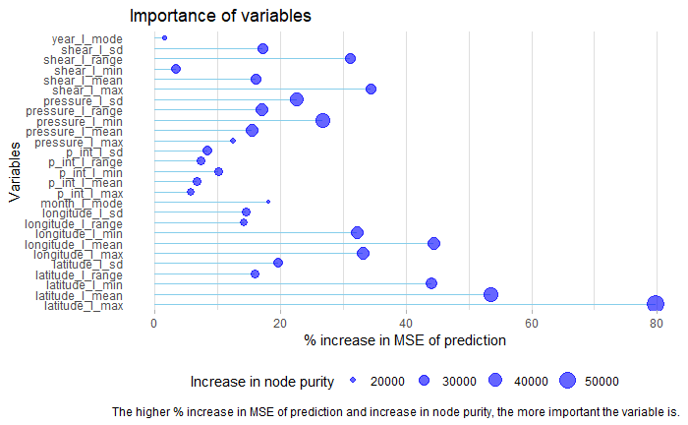
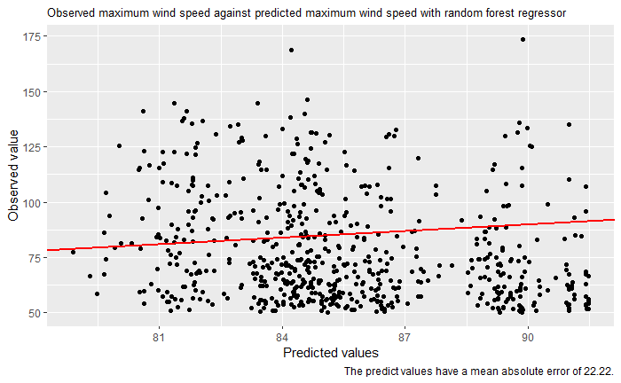
Modeling & Results
Random Forest: Variables importance visualization
Regression results from Random Forest model

Slide 16
Models Comparison
Attributes/Model | Linear regression | Linear regression (forward stepwise) | Partial least squares regression | Random Forest Regression
MAE | 16.65 | 16.67 | 17.27 / 16.76 | 22.22
Number of predictors | 27 | 12 | 3 / 11 components | 9 at each tree

Slide 17
Future works
Feature selection
Fine tuning models
Build and fine tune models for predicting presence/ absence of rapid intensification

